Slide 1

2GA3 Tutorial #3
DATE: October 1st, 2021
TA: Jatin Chowdhary

Slide 2
Pay Attention
Next slide is very important
Listen to this carefully
  This information might save your life one day
    Seriously

Slide 3
FIPPA
What is FIPPA?
  Freedom of Information and Protection of Privacy Act
Why care?
  Use it for secure/confidential communication
    Great for disclosing information you do not want anyone else but the intended party to see
      i.e. Allergies (Food, chemicals, etc.)
    i.e. Inform on person X to person Y
How to properly use it?
  By law it's already used to protect communication
    But it's good practice to state it
  i.e. On next slide

Slide 4
FIPPA Example
Dear Professor X,
I am writing this email to inform you about an incident that occurred on March 3rd, 2017, with a person who goes by the name of Logan. Mr. Logan consumed a peanut butter and jelly sandwich while being fully aware of my food allergies. Had I not taken the appropriate action to protect myself, serious harm could have occurred. Please take necessary action to alleviate this issue. Furthermore, I expect the contents of this email to remain confidential in accordance to FIPPA. Please do not disclose my identity, or any other identifying information to any party involved directly or indirectly, without my consent.
Regards,
Scott Summers

Slide 5
Participation
The script
  Everyone will be called upon, once
Why?
  This is the best way to learn
  Repitition is the language of the brain
    Speech > Writing
    It's how our brain are wired
      Millions of years of evolution
  Participating > Taking notes
    Everything will be posted
    Last tutorial on Friday is recorded
      Just pay attention and (immediately) ask questions!

Slide 6
I Don't Know
If I call on you, and you don't know, just say, "I don't know"
  Ain't nothing wrong with this
  Everyone is here to learn
  Proudly say, "I don't know"
    You'll learn better this way; it takes away the pressure
    It's the best answer
If you still don't get it, ask for clarification!
  No one gets it right away
    It takes a few tries, but eventually you will get it, and that's all that matters

Slide 7
Clarification (1)
Made a mistake about sw and sd during last week's tutorial
  The mistake is underlined below:
    64-Bit:
      sub x30, x28, x29 // Compute [i – j]
      slli x30, x30, 3 // Multiply by 8 to get byte offset
      add x3, x3, x30 // Calculate location in memory
      ld x30, 0(x3) // Load A[i – j]
      sd x30, 64(x11) // Store in B[8]
    32-Bit:
      sub x30, x28, x29 // Compute [i – j]
      slli x30, x30, 2 // Multiply by 4 to get byte offset
      add x3, x3, x30 // Calculate location in memory
      lw x30, 0(x3) // Load A[i – j]
      sw x30, 32(x11) // Store in B[8]

Slide 8
Clarification (2)
I can't remember what I said, but:
  The difference in 64-bit and 32-bit RISC-V code (in the previous slide) is:
    slli
      3 vs. 2
    ld vs. lw
    sd vs. sw
    64(x11) vs. 32(x11)
      The number to the left of the brackets is the byte offset in memory
        The data is stored memory that corresponds to the value in x11 (base address), with an offset of 32 or 64
      Why are 8 (64-bit) and 4 (32-bit) so special?
        Explained on next slide

Slide 9
Mistake
What I said last week was a bit misleading
  Does everything make sense?
Sorry for the mistake
  If you make a mistake, come clean
    Great way to learn, because you'll never forget
  Be honest
We are all here to learn

Slide 10
Word
Question: How big is a word?
Options:
  16-bits
  8-bits
  31-bits
  32-bits
  33-bits
  None of the above
  As big as you want

Slide 11
Double Word
Question: How big is a double word?
Options:
  60-bits
  61-bits
  62-bits
  63-bits
  All of the above
  None of the above

Slide 12
Byte Offset (1)
In a 32-bit system, the byte offset is calculated by multiplying by 4
  For 64-bit, multiply by 8
Why these specific numbers?
  First of all, what does 32-bit mean?
    Question: If I say the architecture of this computer is 32-bits, what does that mean?
    Question: What is 1 bit?
      In the context of binary numbers
    How many bits in a byte?
  Calculation
    Next slide

Slide 13
Byte Offset (2)
For a 32-bit system, we divide 32 bits by 8 bits to get the size of the block, in bytes
  32 bits / 8 bits = 4 bytes
What is the size of the block, in bytes, for a 64-bit system?
  X bits / Y bits = Z bytes

Slide 14
128-Bit Architecture
Question: To calculate the byte offset in a 128-bit computer, what number would you use to multiply?
Options:
  12 bytes
  14 bytes
  16 bytes
  18 bytes
  20 bytes

Slide 15
Any Questions?
Does that make sense?
All good?
Redo it?

Slide 16
Food
If you have food allergies, let me know!
  Same with dietary restrictions
    Use FIPPA
Anyone hungry?
  Snacks in my bag
    Whoever asks the most questions, gets a piece

Slide 17
Recap SLLI (1)
slli = shift left logical immediate
  Example for Base 10:
    Perform slli, once, on (999)10
      Answer: Multiply 999 by 10, because we are dealing with base 10 numbers
    Perform slli, twice, on (200)10
      Answer: Multiply X by Y
        Help me out!
  General rule?
    Next slide

Slide 18
Recap SLLI (2)
General rule is:
  For every slli, add a 0
    Translation: Multipy by X, where X is the base of the numbers you are working with
      i.e. (slli, 1) on (900)10 = 900 x 10 = 9000
      i.e. (slli, 2) on (11)2 = 11 x 2 x 2 = 01100
        Note: This is NOT "eleven"
    Note: Only use this trick for (Base)2

Slide 19
More About SLLI
Going overboard!
  Assume you are working with a 4-bit architecture, where the maximum possible number is (1111)2.
    What is the result of: (slli, 2) on (1001)2?
      Remember: The largest possible number is (1111)2
      Is the answer: (100100)2
Conclusion: Information is _ _ _ _ !
  Same thing happens for srli
    srli = Shift Right Logical Immediate

Slide 20
Any Questions?
Does that make sense?
  Any questions about anything I've said?
Ask now or forever...

Slide 21
No Time
I still gotta clarify:
  CMOS/PMOS/NMOS
    Note: Was discussed during office hours
  32-Bit vs. 64-Bit
  'strcpy' Example
Always running out of time
  Will try to cover next week
    Or the week after that
      Or after that
        Or after that

Slide 22
Question #1 (2.13)
For the following instruction, what is the instruction type? And what is the hexadecimal representation?
sw x5, 32(x30)
^{rs2 imm rs1}
Answer:
  Next slide
    Pay attention; this is VERY important

Slide 23
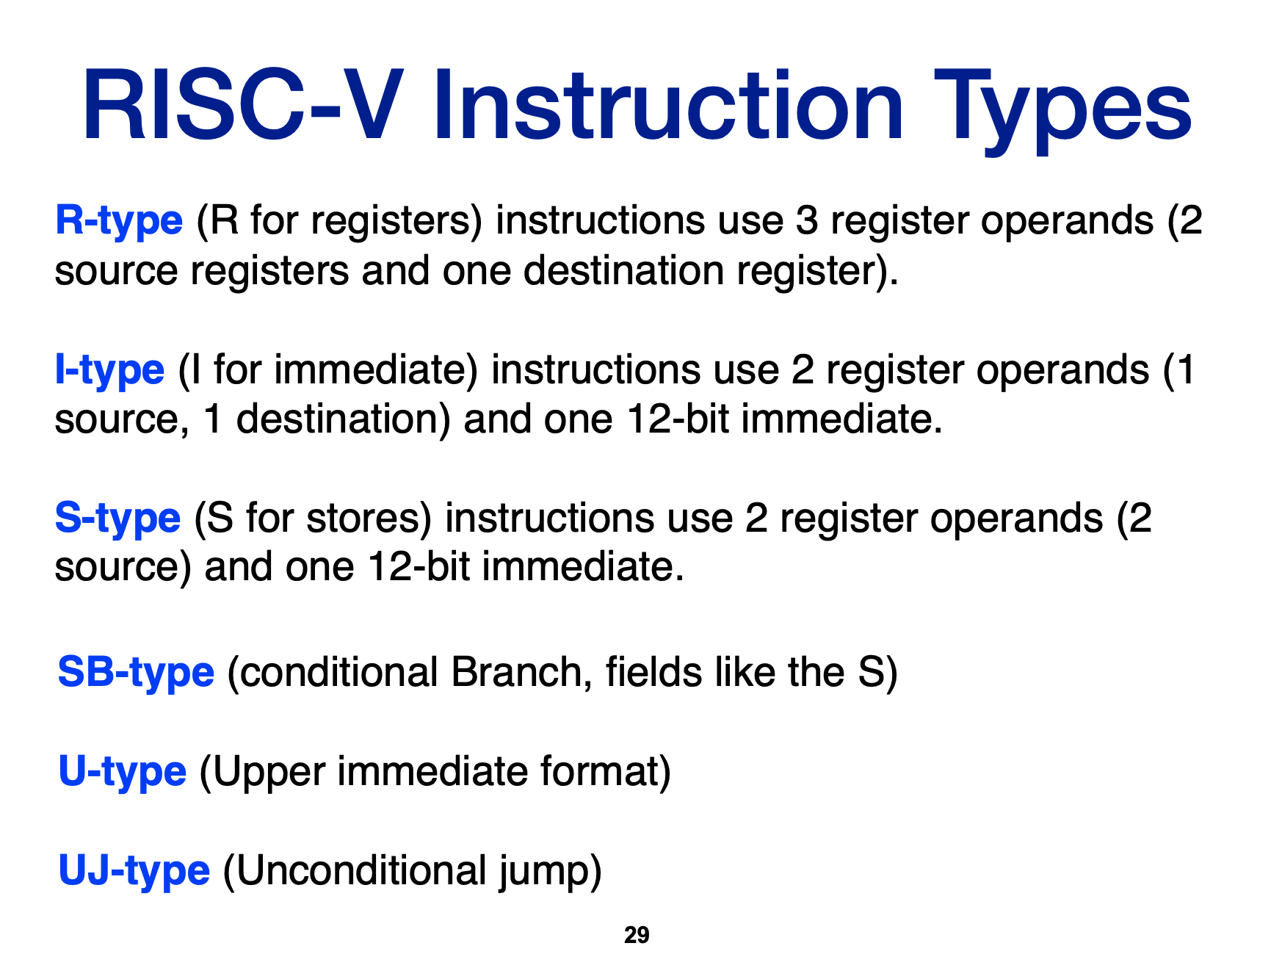
Answer #1 (2.13)
What is the instruction type?
  The instruction is sw, which stands for store word
    Hence, it is a _ _ _ _ _ instruction, making it an _ type
Refer to lecture slides:

Slide 24
Answer #1 (2.13)
What is the hexadecimal representation?
  First, get the binary representation
    Then, convert to hexadecimal
Answer:
  We've already established that we are dealing with an S-type instruction
    So let's see what the format is for an S-type instruction
      Next slide

Slide 25
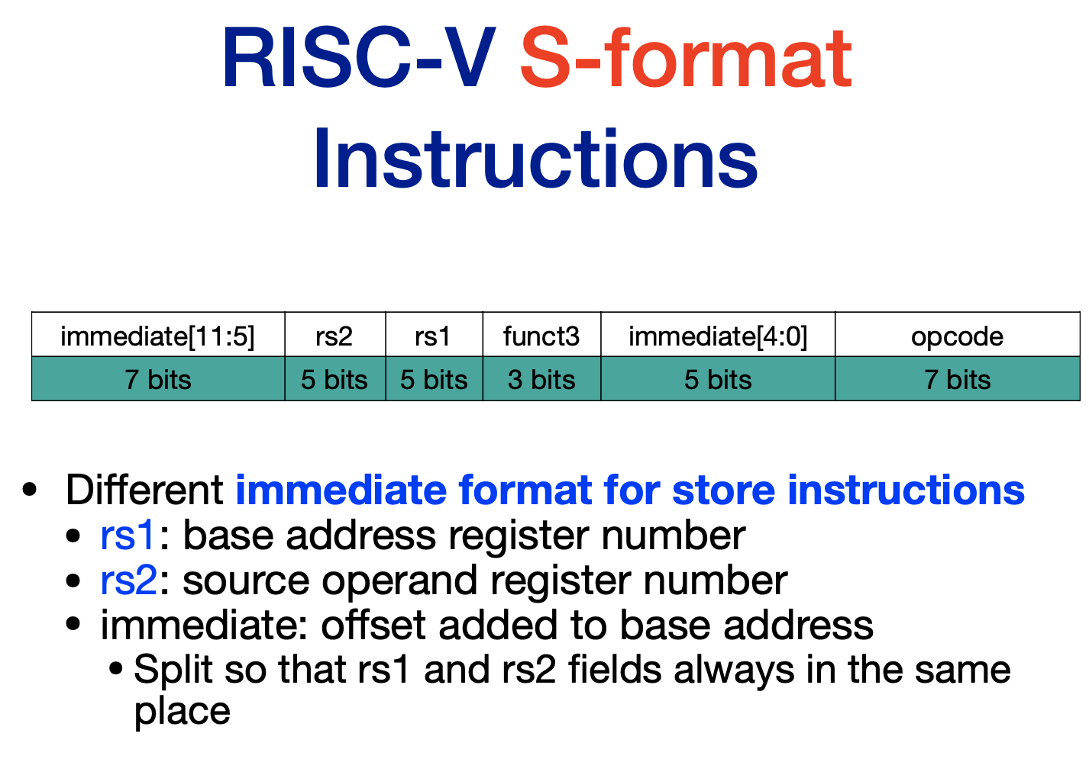

Slide 26
Answer #1 (2.13)
So, we need:
  opcode (7 bits)
  funct3 (3 bits)
  rs1 (5 bits)
  rs2 (5 bits)
  immediate (5 + 7 bits)
How do we get this information?
  From the RISC-V instruction list!
    opcode = 0100011
    funct3 = 010
    rs1 = (30)10
      (011110)2 → (11110)2
    rs2 = (5)10
      (101)2 → (00101)2
    Immediate = (32)10
      (100000)2
Now what?
  Next slide

Slide 27
Answer #1 (2.13)
Put it all together!
  opcode = 0100011
  funct3 = 010
  rs1 = 11110
  rs2 = 00101
  immediate = 100000
    Immediate[4:0] = 00000
      [4:0] means: Take the first 5 least significant bits; from the 0th bit to the 4th bit
    Immediate [5:11] = 0000001
      [5:11] means: The range is from the 5th bit to the 11th bit
The final answer is:
  immediate[5:11] + rs2 + rs1 + funct3 + immediate[4:0] + opcode
    0000001 00101 11110 010 00000 0100011

Slide 28
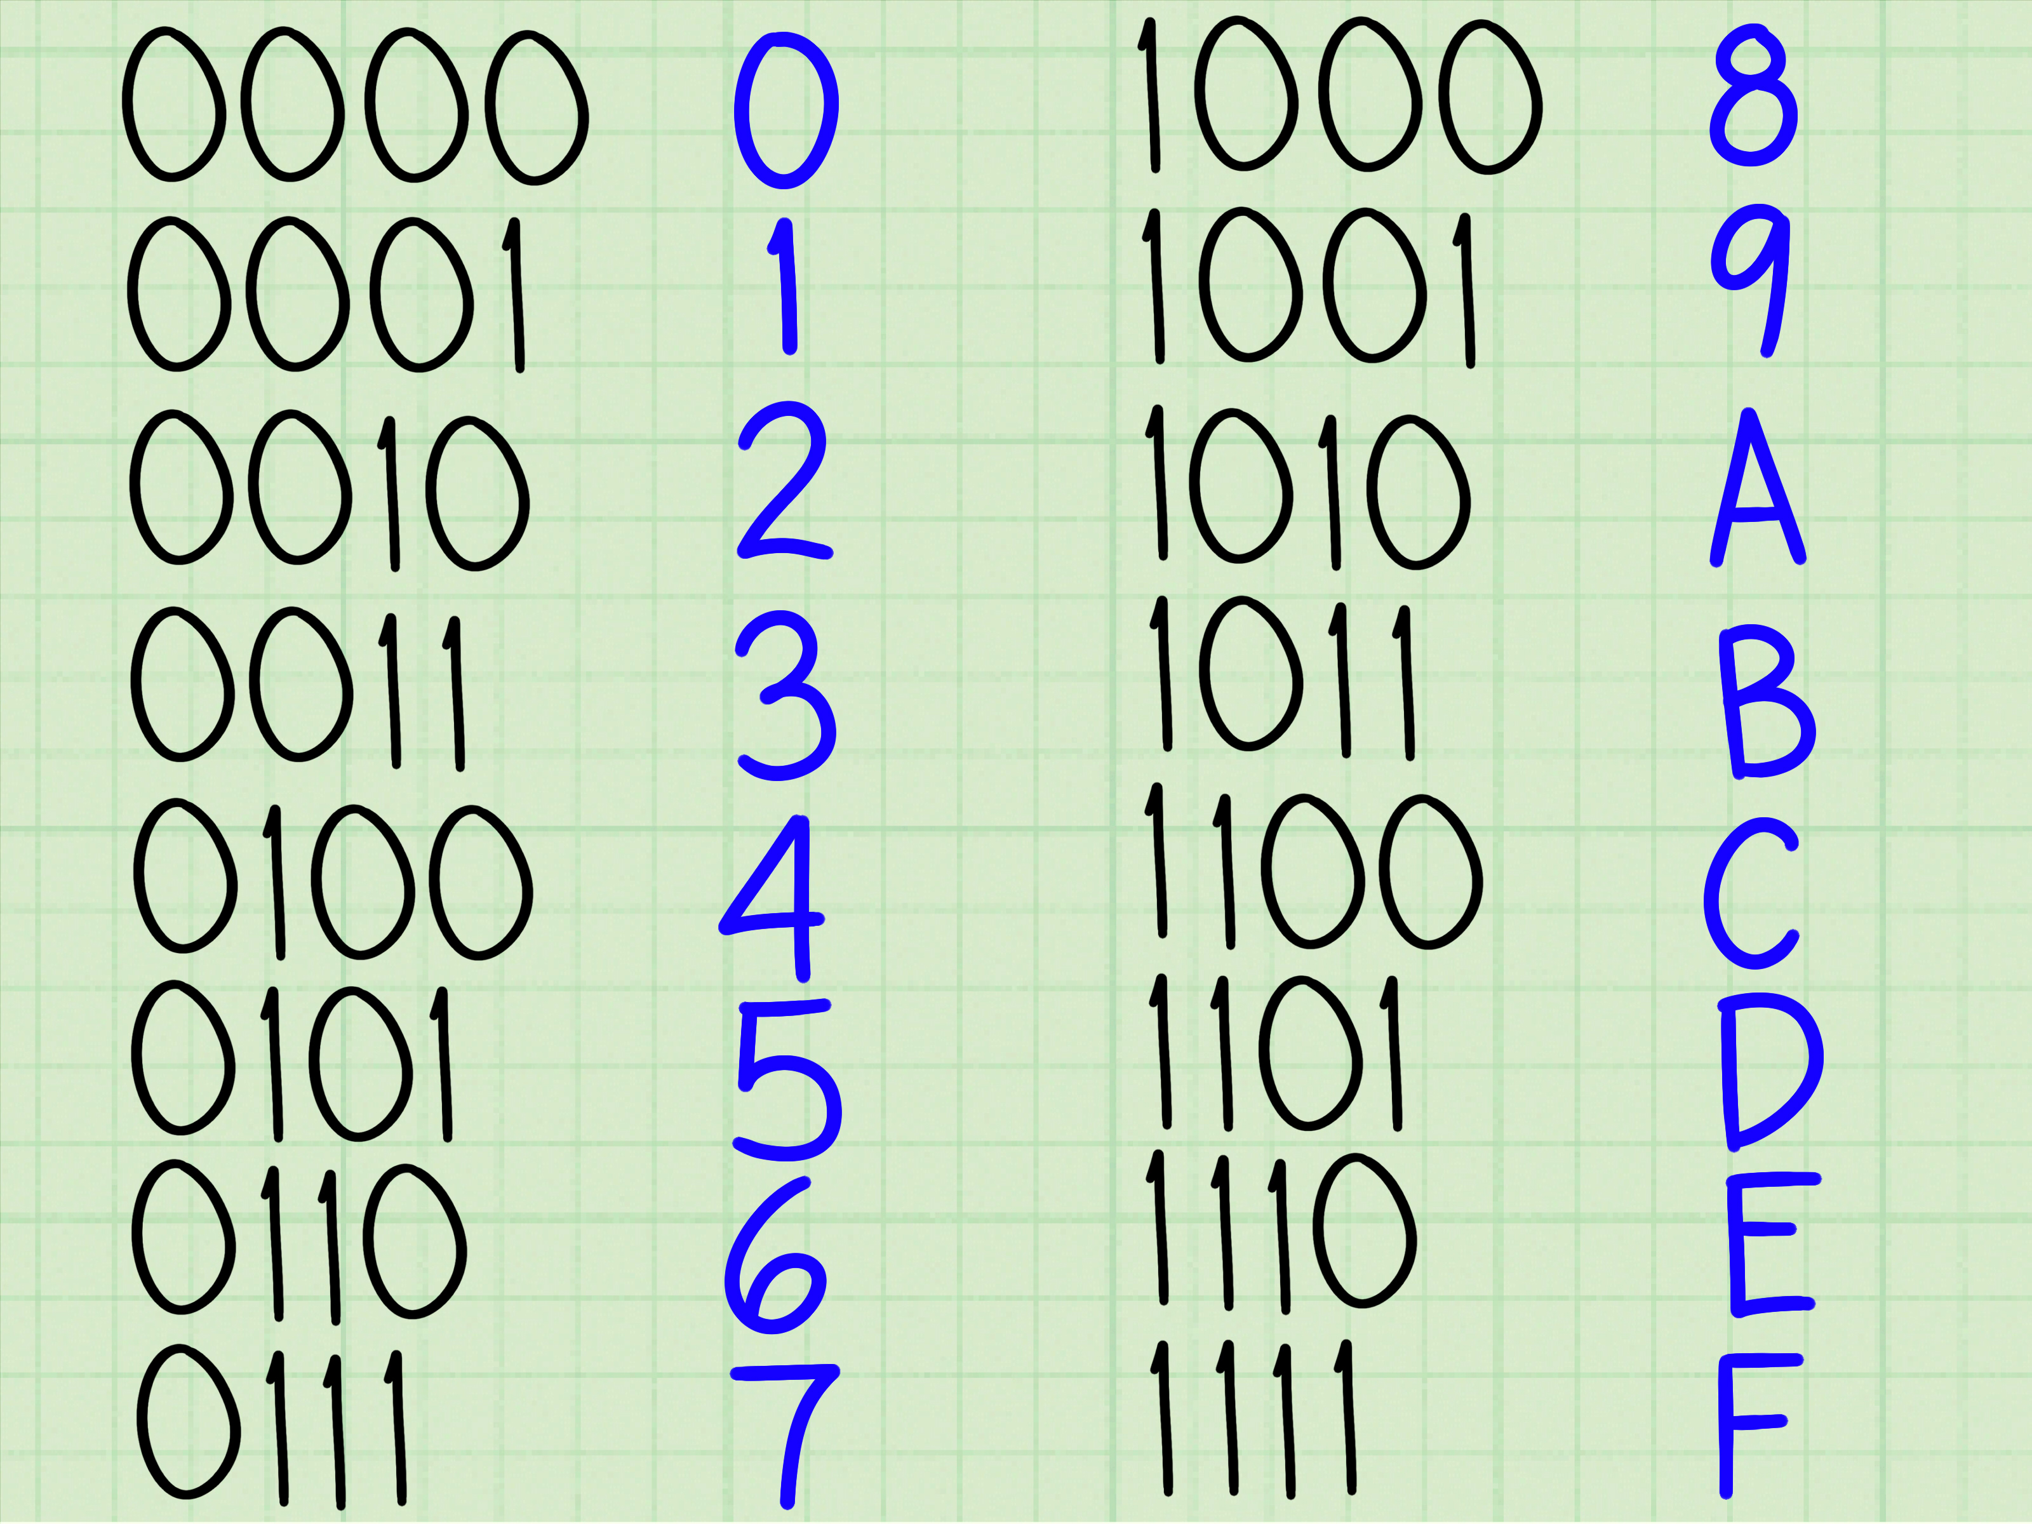
Answer #1 (2.13)
How to convert to hexadecimal?
  1. Take our answer and remove all spaces:
    00000010010111110010000000100011
  2. Add a space after every 4th bit:
    0000 0010 0101 1111 0010 0000 0010 0011
  3. Use the table, on the right, to convert to hex:
    0x025f2023

Slide 29
Clarification For #1 (2.13)
Question: Why is the immediate value separated into 2 parts?
  Answer: To keep the format of the instructions consistent, which makes decoding easier
    For more information: See lecture slides
Question: What is 0x?
  Answer: It is convention to prefix hexadecimal numbers with 0x. It tells the compiler (and you) that the number is in hexadecimal
    i.e. 0xFFFF
      Hexadecimal
    i.e. 0b11101
      Binary
    i.e. 0o35
      Octal
  We denote different bases via subscripts, the compiler/parser uses 0x

Slide 30
The Big Picture!
Everything in a computer's memory is just 1's and 0's
  i.e. 00000010010111110010000000100011
    Registers, Cache, Main memory, HDD, etc. contain of 0's and 1's
So when you send an instruction to the CPU, you're just sending a bunch of 0's and 1's like the example above
  The 1's and 0's are generated by the waves (Draw This)
    Waves = Low voltage and high voltage
  The more waves there are, the more _ _ _ _ we can send
    The _ _ _ _ are sent from main memory to the CPU through the _ _ _
      The _ _ _ _ _ rate of a CPU measures the "_ _ _ _ _"

Slide 31
Question #2 (2.17)
Assume that the following registers contain:
  x5 = 0x0000AAAA
  x6 = 0x12345678
For the register values shown above, what is the value of x7 after the following sequence of instructions?
  slli x7, x5, 4
  or x7, x7, x6
For the register values shown above, what is the value of x7 after the following sequence of instructions?
  srli x7, x5, 3
  andi x7, x7, 0x1EF

Slide 32
Answer #2 (2.17)
slli x7, x5, 4
  = 0x0000AAAA × (2 x 2 x 2 x 2)
  = 0x0000AAAA × (16)
  = 0x000AAAA0
or x7, x7, x6
  0x000AAAA0 OR 0x12345678
000AAAA0: 0 0 0 0 0 0 0 0 0 0 0 0 1 0 1 0 1 0 1 0 1 0 1 0 1 0 1 0 0 0 0 0
12345678: 0 0 0 1 0 0 1 0 0 0 1 1 0 1 0 0 0 1 0 1 0 1 1 0 0 1 1 1 1 0 0 0
0123efef8: 0 0 0 1 0 0 1 0 0 0 1 1 1 1 1 0 1 1 1 1 1 1 1 0 1 1 1 1 1 0 0 0

Slide 33
Answer #2 (2.17)
srli x7, x5, 3
  = 0x0000AAAA ÷ (2 x 2 x 2)
  = 0x0000AAAA ÷ (8)
  = 0x00001555
andi x7, x7, 0x1EF
  = 0x00001555 AND 0x000001EF
  = 1555 AND 01EF
  = 0???
  = 0145
Hexadecimal | Binary
555 | 0101 0101 0101
1EF | 0001 1110 1111
145 | 0001 0100 0101

Slide 34
Clarification For #2 (2.17)
Question: Do I have to convert to binary, perform the operation and then convert back?
  Answer: There's a trick to performing these operations for base16 numbers
    Because base2 numbers are 2¹ and base16 numbers are 2⁴
      2⁴ = (2¹)⁴
  You should try to figure it out, before asking me to spill the beans
    Practice as much as you can!

Slide 35
Question #3 (2.23)
Homework
  You can find all questions/solutions on Teams
    Check the Files tab
  Don't look at the answer before starting

Slide 36
Question #4 (2.23)
For the following C statement, write a minimal sequence of RISC-V assembly instructions that performs the identical operation.
Assume x6 = A, and x17 is the base address of C.
A = C[0] << 4; // C Code

Slide 37
Question #4 (2.23)
First of all:
  What is A ?
  What is C[0] ?
    Where is C[0] stored?
      Which instruction do we use?
  What is << ?
    What is the equivalent instruction for this?

Slide 38
Answer #4 (2.23)
Solution:
ld x6, 0(x17) // x6 = C[0]
slli x6, x6, 4 // x6 = x6 * 16

